Slide 1

Welcome!!
How would you convince someone to quit smoking in their twenties, thirties, forties, and sixties?

Slide 2

Project Management
Data Analysis Report and Presentation

Slide 3
Our Team Layout
Kaushik Patel
Kartik Sojitra
Rajesh Kumar
Heet Soni

Slide 4
Road Map
How would you convince someone to quit smoking in their twenties, thirties, forties, and sixties?
1
2
3
4
5
Executive Summary
Methods
Results
Conclusion
References

Slide 5
Project Risk
In this project there are various risks related to COVID-19 that might affect the production of the products. The major risks that affect the project are as follows:
Production of the Products: Due to the pandemic there is an increased demand of the hand sanitizers and face masks. This makes it difficult for the company to manage the production of the products in a short span of time.
Lack of Coordination: As mentioned earlier in the project the team members are new and will be working with each other for the first time and hence, this will affect the work process as the there will be problem in the coordination among the members.
Delay in the Deliverables: Due to the pandemic the deadline of the project might be affected as the resources are less and the amount work to be completed is more.
Lack of Resources: the raw material needed for the production of the products are to ordered from other vendors and due to the lockdown the company will face difficulty in getting the resources on time.
Scarce Man Force: The contract given by the government is big enough that it requires more workforce and arranging the workforce in such short time is difficult.

Slide 6
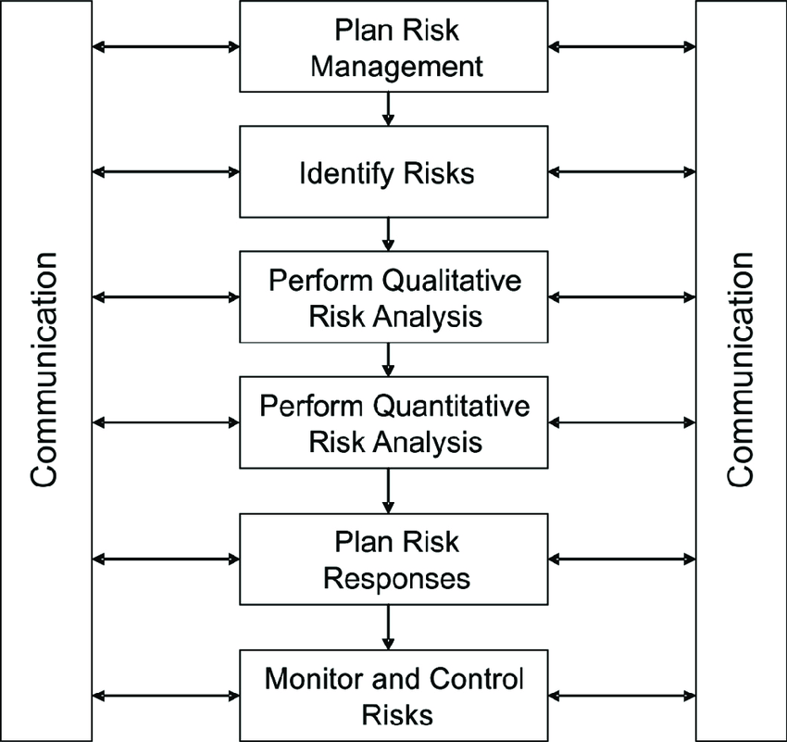
Risk management Process

Slide 7
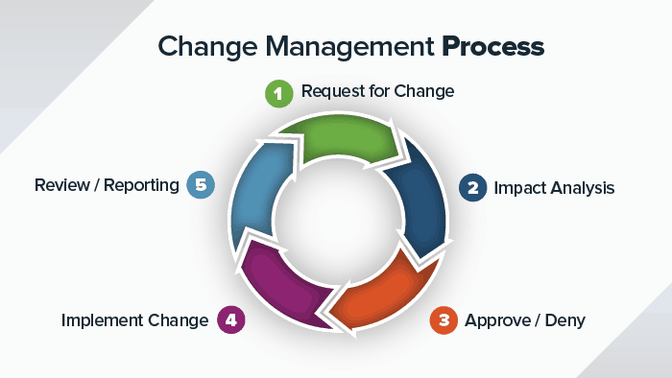
Change management Process

Slide 8
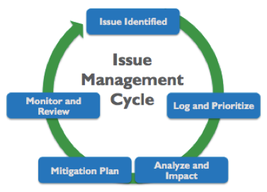
Issue management Process

Slide 9
Thank you
Smoking is bad for you

